Slide 1
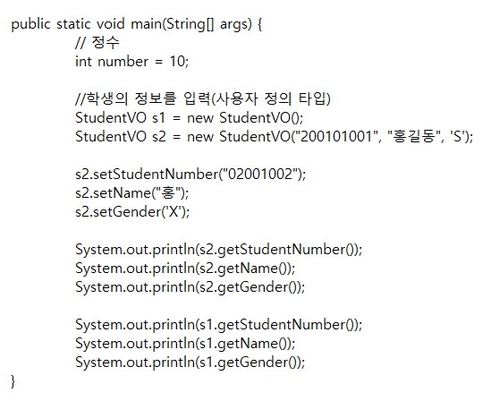
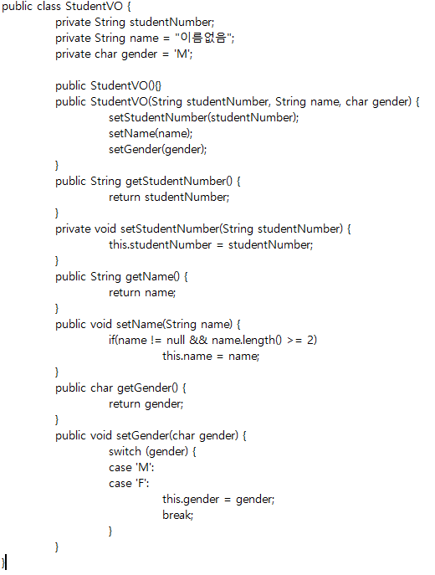
studentNumber
name
gender
getStudentNumber()
setStudentNumber(String)
getName()
setName(String)
getGender()
setGender(char)
StudentVO()
StudentVO(String, String, char)
S1

Slide 2
studentNumber
name
gender
getStudentNumber()
setStudentNumber(String)
getName()
setName(String)
getGender()
setGender(char)
StudentVO()
StudentVO(String, String, char)
studentNumber
name
gender
getStudentNumber()
setStudentNumber(String)
getName()
setName(String)
getGender()
setGender(char)
StudentVO()
StudentVO(String, String, char)
S2
S1

